Slide 1
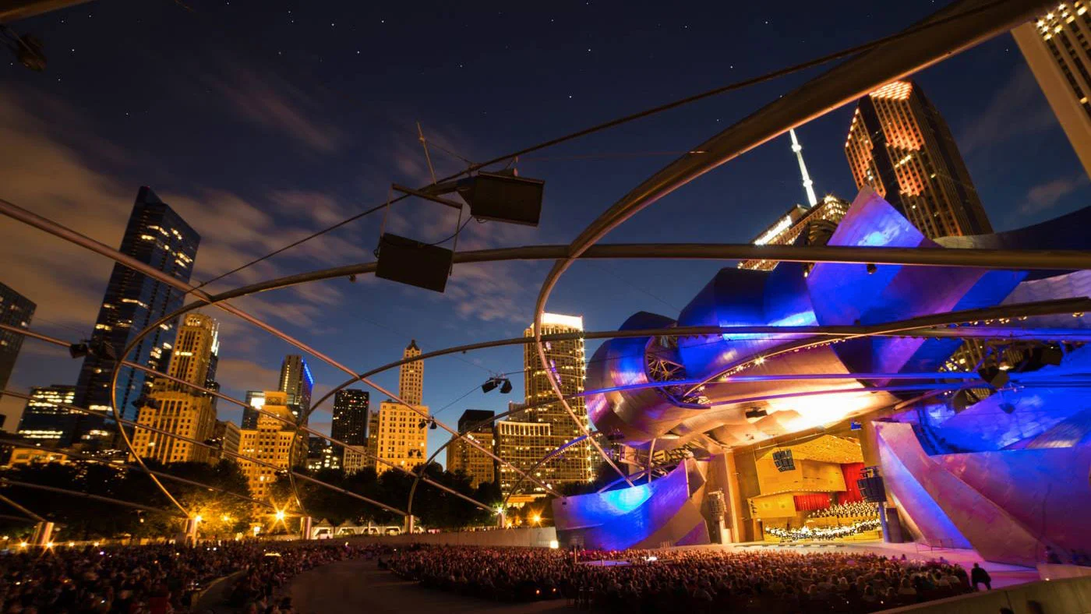
The Millennium Music Festival
Millennium Park, Chicago
October 21-23, 2022
genre: blues, hip-hop, rock&roll
800 music enthusiasts

Slide 2
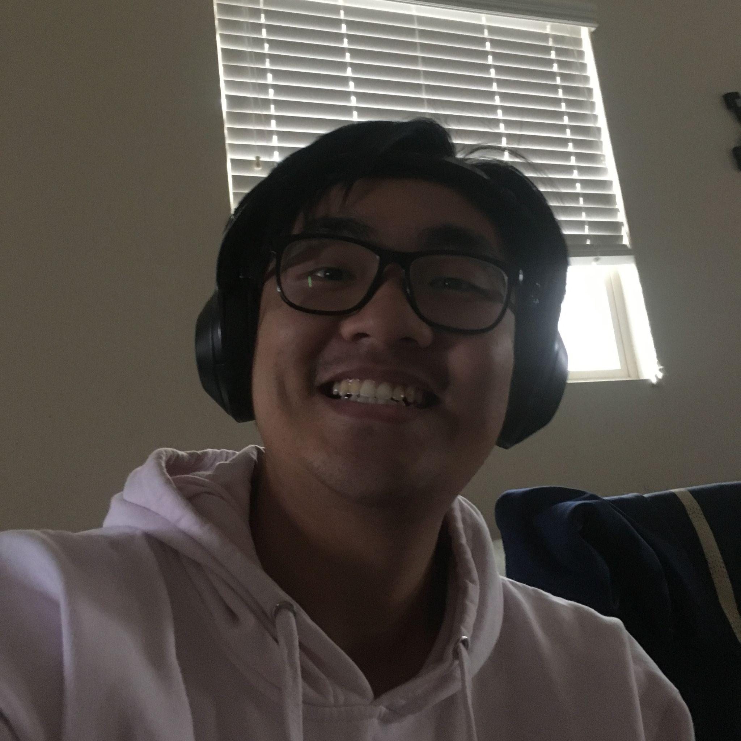
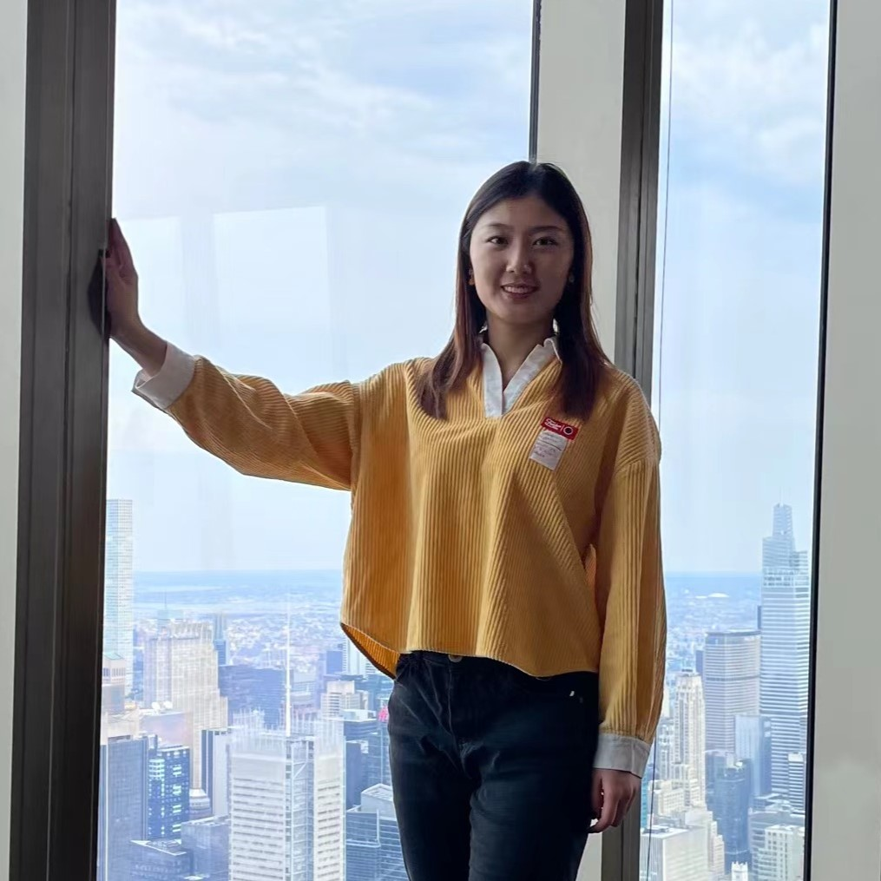

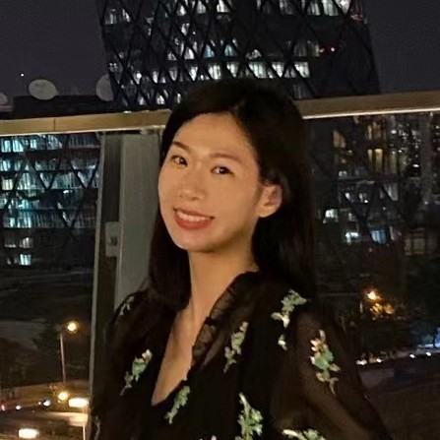
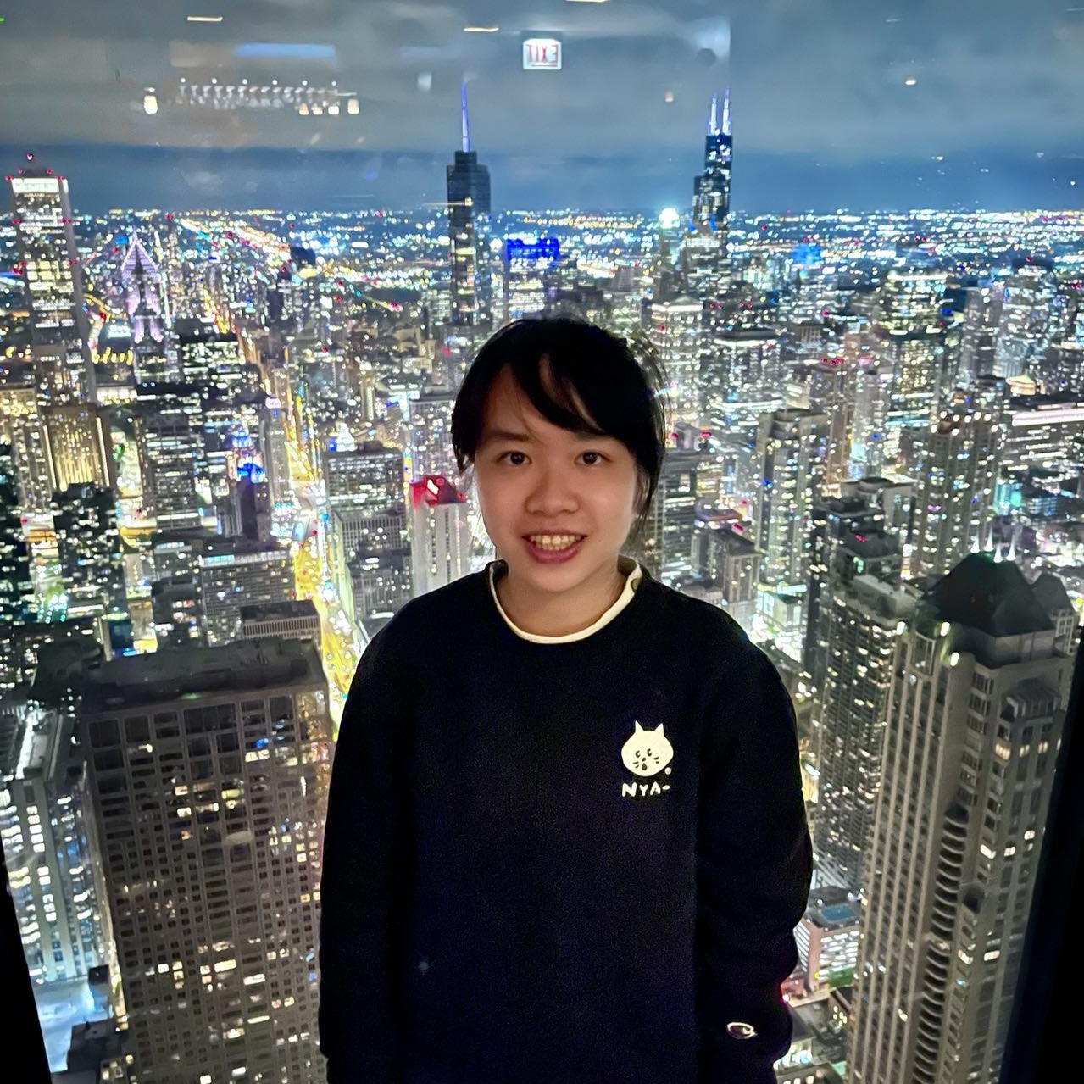
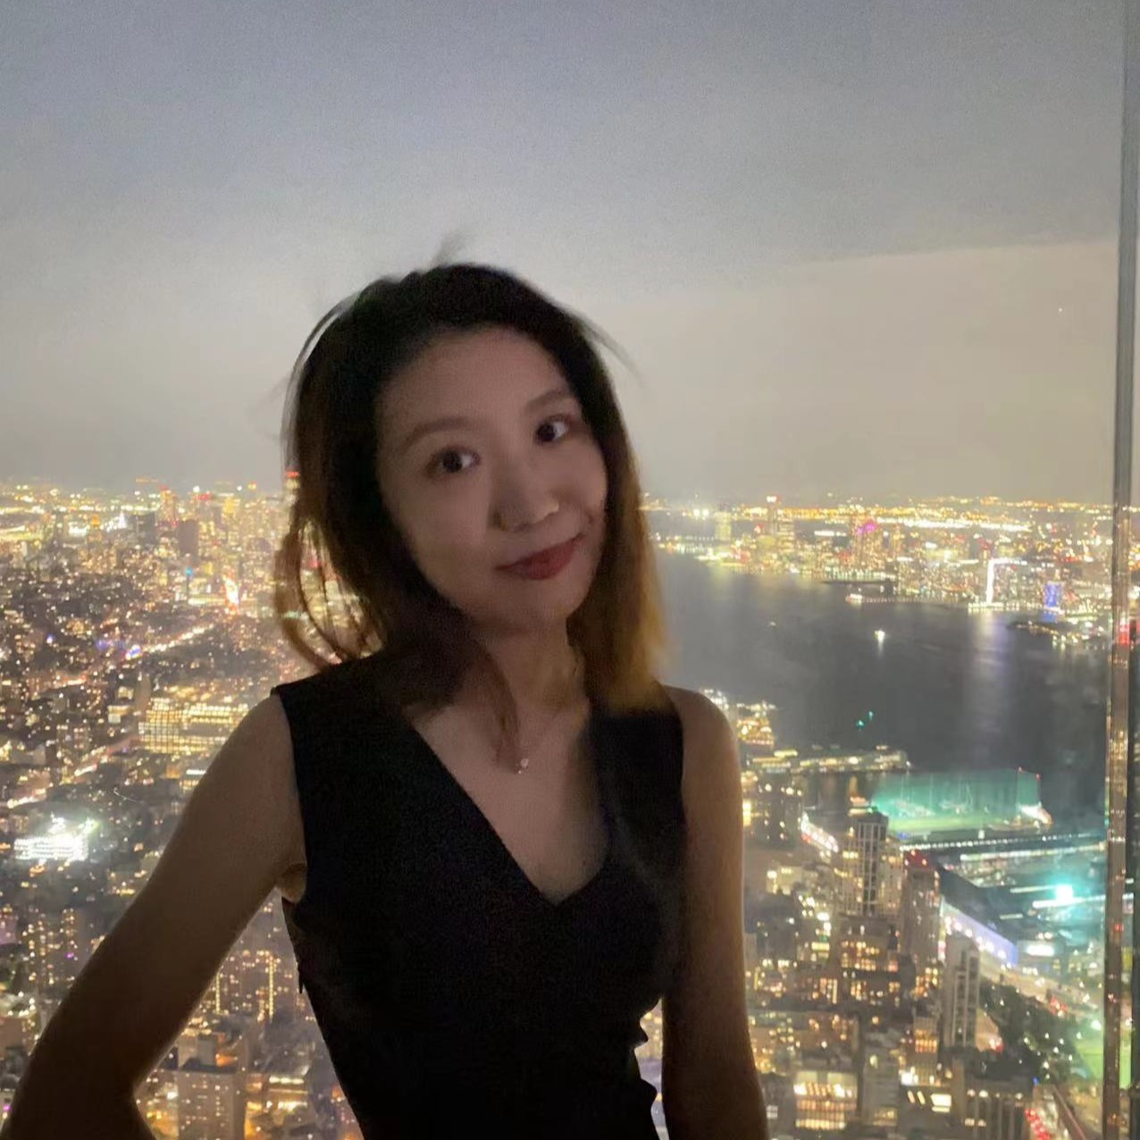
Our Team
Tiancheng Zhou
Yiran Wang
Weiyi Xia
Sarah Sun
Yushan Lin
Shiyu Hua

Slide 3
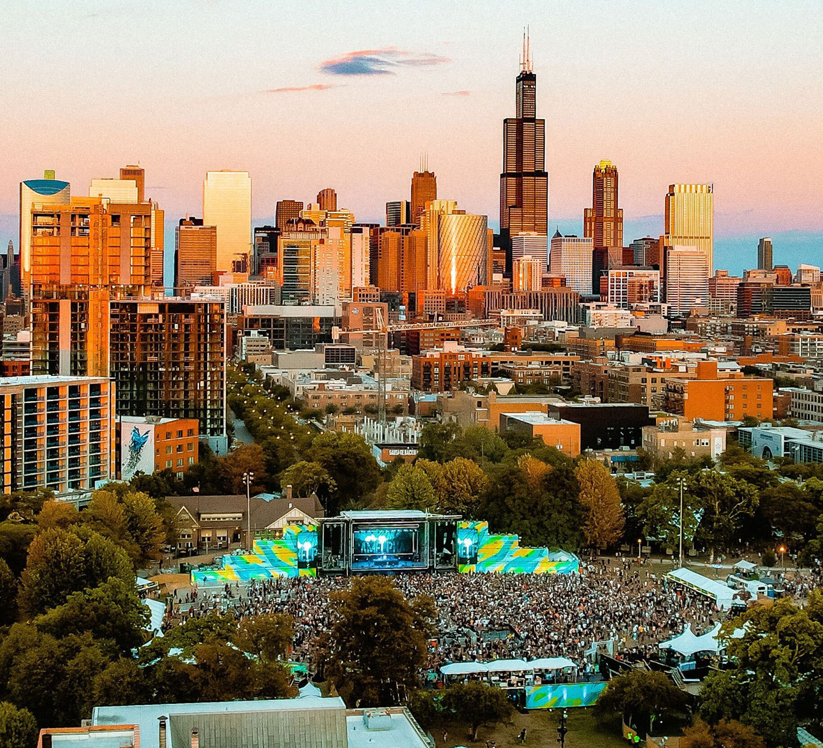
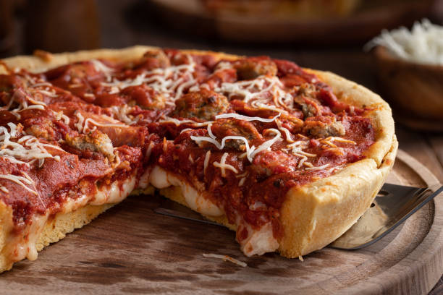
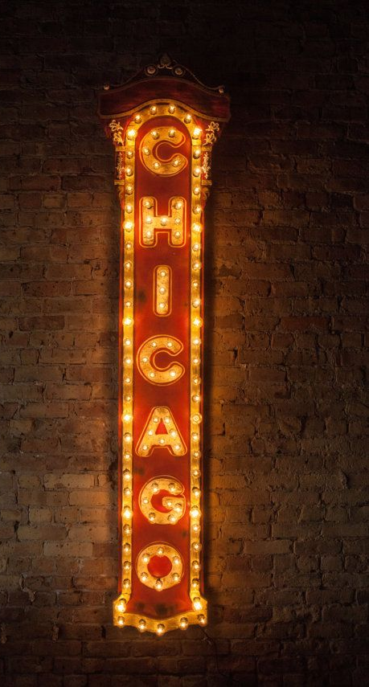
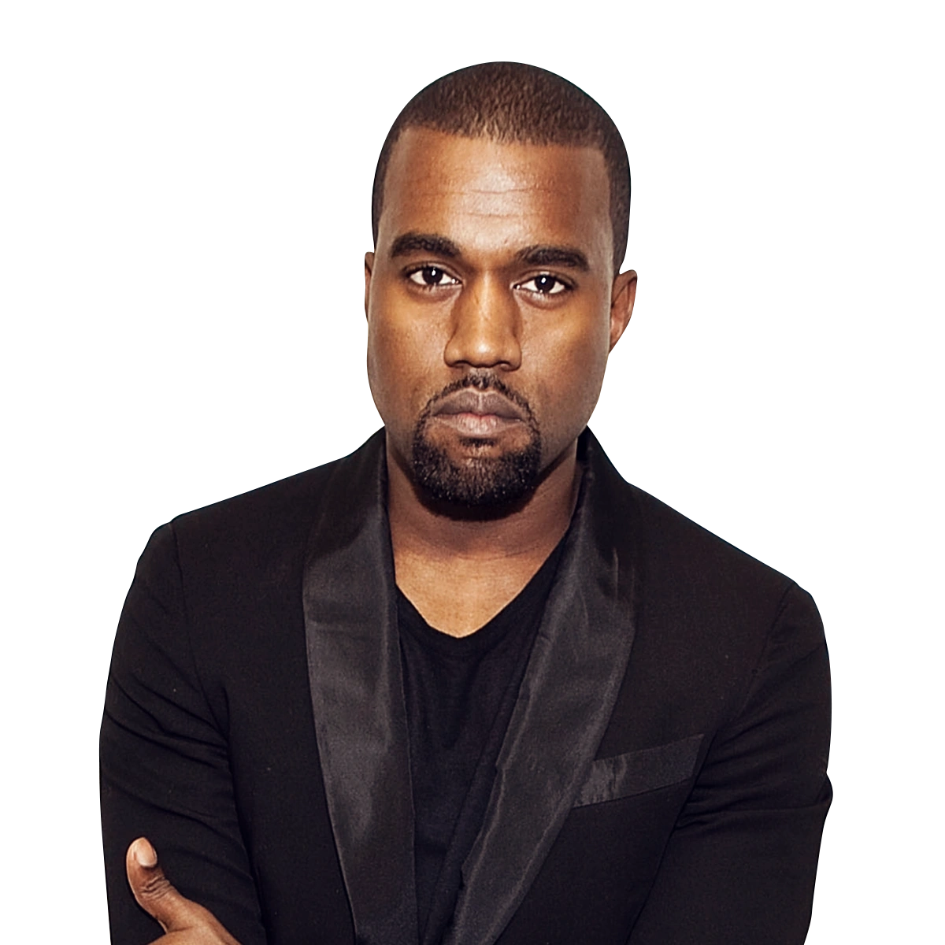
Why is Chicago?
Important contributions to the genres of blues, jazz, and gospel
Landmarks: the Willis Tower, the Art Institute of Chicago, the Goodman Theatre, and the Magnificent Mile
Best bites from hot dogs to deep dish pizza
Notes:
home of hip-hop artists like Kanye West
Art lovers can check out the masterpieces on display at the Art Institute of Chicago, theatre-goers can watch a play at the Goodman Theatre, and those who love to shop can spend some time on the Magnificent Mile.
Chicago's food scene is known for everything from hot dogs and deep dish to acclaimed fine dining. Come try it all.

Slide 4
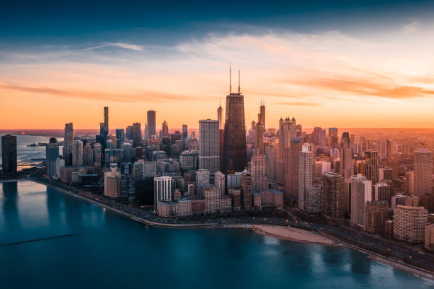
Project Milestones
DATA
Selected the Millennium Park, Chicago as location and blues, hip-hop, rock & roll music as theme for the festival
Gathered data across artists, songs, hotels, restaurants, and attractions
DATABASE
Created a normalized relational database from the data collected
Built an ETL process to clean, modify, and upload the data to the database
Linked 8 tables together
OUTPUT
Developed a Shiny App interface to deliver an intuitive user experience for the music festival and its offerings

Slide 5


The Shiny App
Sections
Festival Welcome Page
Artist Lineup
The Venue
Plan the Stay
Hotels
Restaurants
Attractions

